Slide 1

BOCTOPUS: improved topology prediction of transmembrane β barrel proteins
Sikander Hayat and Arne Elofsson.
Structural bioinformatics. Vol. 28 no. 4 2012, pages 516–522. DOI:10.1093/bioinformatics/btr710.
Marina Martínez Hernández
March 2018

Slide 2
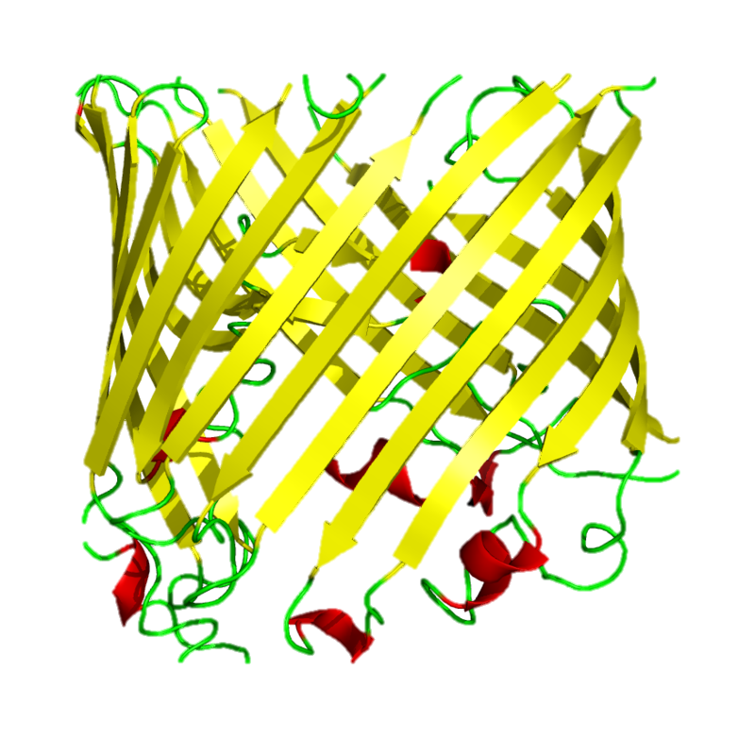
INTRODUCTION: Transmembrane β barrel proteins (TMBs)
Outer membrane of gram-negative bacteria, chloroplasts and mitochondria.
Many known functions
Translocation machinery
Molecular transport
Pore formation
Etcetera
Scarce TMBs structures in PDB

Slide 3
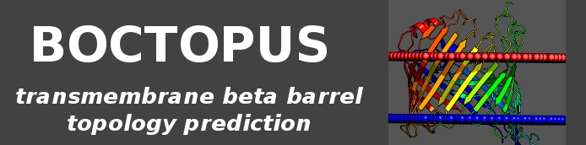
INTRODUCTION: Computational methods in the realm of TMBs
Identification of TMBs
Prediction of TMBs’ topology
SVMs (Park et al., 2005)
Hidden Markov Models (HMM) (Deng et al., 2004; Martelli et al., 2002)
Neural Networks (Gromiha and Suwa, 2006; Gromiha et al., 2004)
K-nearest neighbor methods (Hu and Yan, 2008)
Etcetera
HMM-based methods
PRED-TMBB (Bagos et al., 2004)
PROFtmb (Bigelow and Rost, 2006)
SVM-based methods
TMBETAPRED-RBF (Ou et al.,2010)
Neural network-based methods
TMBpro (Randall et al., 2008)
Methods based on statistical potentials
TransFold (Waldispuhl et al., 2006)

Slide 4
METHODS: BOCTOPUS (Elofsson et al., 2012)
Combination of SVMs and HMM
Non-redundant training dataset: 36 TMB structures (OPM)
Based on a 10-fold cross-validation test
Main use: topology prediction

Slide 5
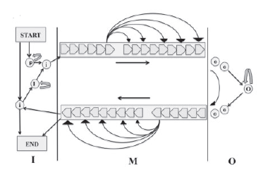
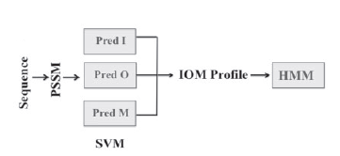
METHODS: Training BOCTOPUS (Elofsson et al., 2012)
Input features
Position-Specific Scoring Matrix
3 iterations, nr NCBI
SVMs training
Preference of each residue
Radial basis, linear kernels
Window size optimization (MCC)
HMMs optimization
Input
Pre-barrel state (P)
4 states
Viterbi algorithm, based on emission scores
BOCTOPUS (Elofsson et al., 2012) pipeline

Slide 6
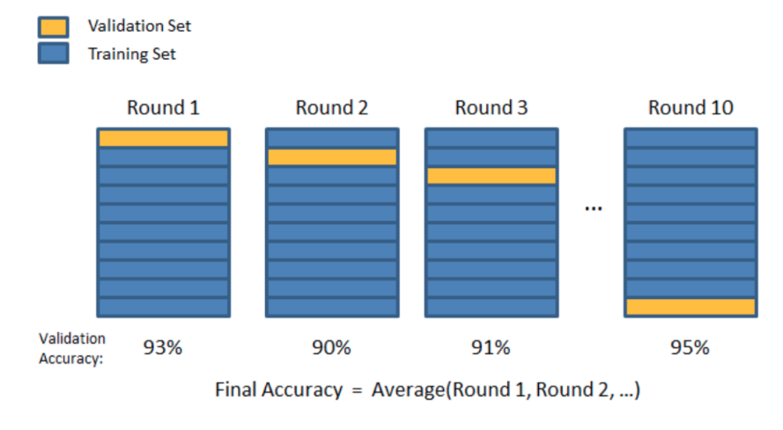
METHODS: Other methods in BOCTOPUS (Elofsson et al., 2012)
Cross-validated models
TMB identification
10-fold cross-validation test
Trained SVMs
10000 top-performing HMMs
Tested on a PDB dataset
Dependent on the number of strands predicted (8)
Evaluation
Q2
Q3
Segment overlap (SOV)

Slide 7
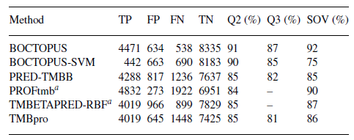
RESULTS: Residue-level prediction accuracy
Q2: two-state prediction
Q3: three-state prediction
Segment overlap

Slide 8
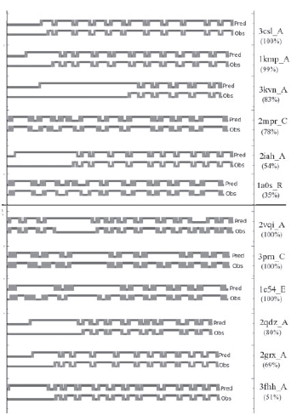
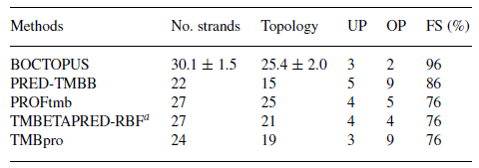
RESULTS: Topology prediction
No. strands
Predicted = Observed
Topology
Predicted overlap at least 2 residues

Slide 9
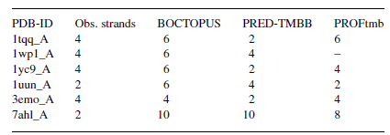
RESULTS: Multi-chain TMB topology prediction
β-strands from different chains
Haemophilus influenzae Hia autotransporter ß (3emo_A)

Slide 10
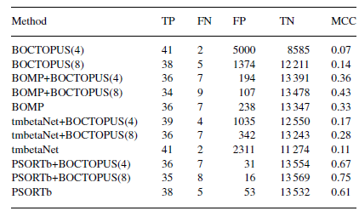
RESULTS: TMB identification
TMB if predicted strands > N
Other methods are better
Secondary structure analysis show enrichment of β-strands in erroneous predictions
PSORTb + BOCTOPUS(8)

Slide 11
CONCLUSIONS
Improved topology
predictor
for TMBs
Higher per residue accuracy
Combined with identification methods, reduce the FP detection of TMBs
Not suitable for multi-chain TMBs predictions

Slide 12
QUESTIONS?

